Slide 1
Cross-platform Mobile App for JIA Research Project
Presenter: Yue Chang

Slide 2

JIA: Juvenile Idiopathic Arthritis
JIA is the most common type of arthritis among children. Nearly 300,000 children in the U.S. have some form of JIA.
Untreated, it can cause serious complications
Identifying JIA is a challenge
Seattle Children’s Hospital is the only screening facility for entire Pacific Northwest region
My project is to develop a mobile app for patients and technicians to take and upload thermal images to quickly get a screening result

Slide 3





How It Works
Architecture and Technology
Mobile app is built using Xamarin
Communication to service is done using REST
Service handles communication to back-end
Patient data is aggregated for analysis
Back-end ML delivers quick screening result
Mobile apps submit patient data
Service handles auth & data

Slide 4

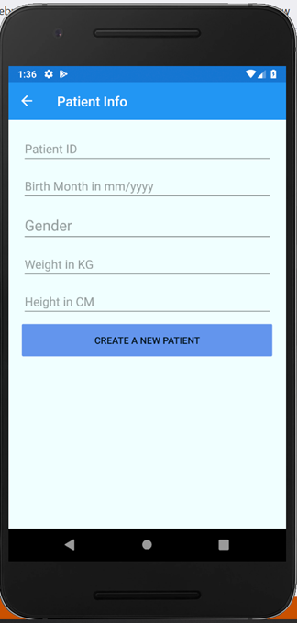
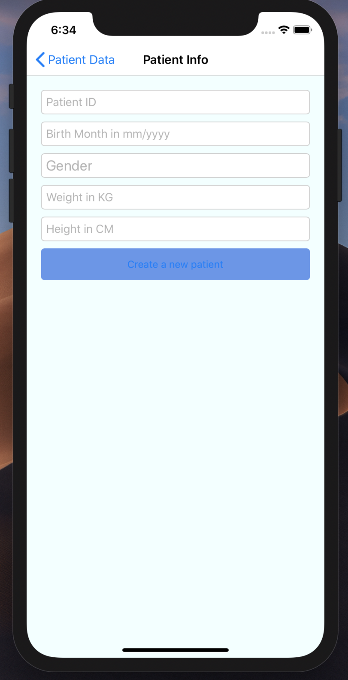
Why Xamarin?
Xamarin is an open-source cross-platform app development platform
JIA App on Android
JIA App on iOS
Building on Xamarin allows a write once, run anywhere approach.
Save development time
Broader patient reach
Simplicity for technicians
Common shared code limits bugs

Slide 5
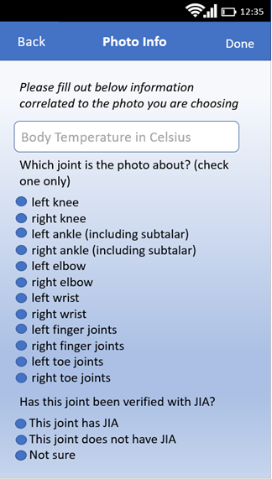
The Work
Main Deliverables
Tooling analysis and investigation
User requirements analysis
Prototype development
Mobile application implementation

Slide 6
Learnings and Next Steps
Relevant Courses:
CSS342 and CSS343: Algorithms and Data Structures
CSS360: Software Engineering
CSS436: Cloud Computing
Next Steps:
Authentication
Service calls
Testing and validation
Lesson Learned:
Communication is key

Slide 7
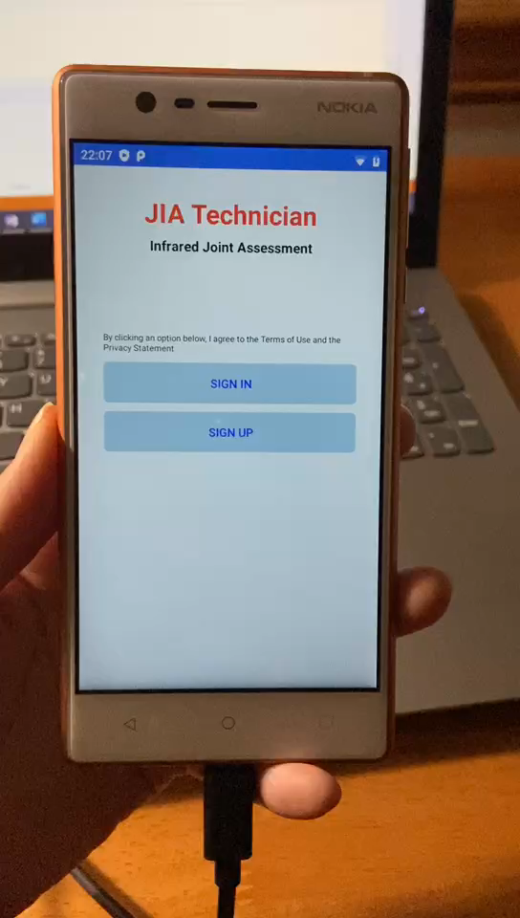
Video Demonstration

Slide 8
Capstone Poster
Switch to poster

